Slide 1
Lecture 3
pointers, pointer arithmetic, functions and strings

Slide 2
C pointers
The name of an Array (e.g. ages) stores an address.
A variable that stores the address of a standard variable (int, float, char) is referred to as a “pointer”;
The array name is called a constant pointer (the address is a constant…)
Declaration and assigning an address value:
int *p; (pointer variable)
int Head =5; (standard variable)
p = & Head;
Printing the value of a pointer (p); and the value of the variable whose address is stored in p :

Slide 3
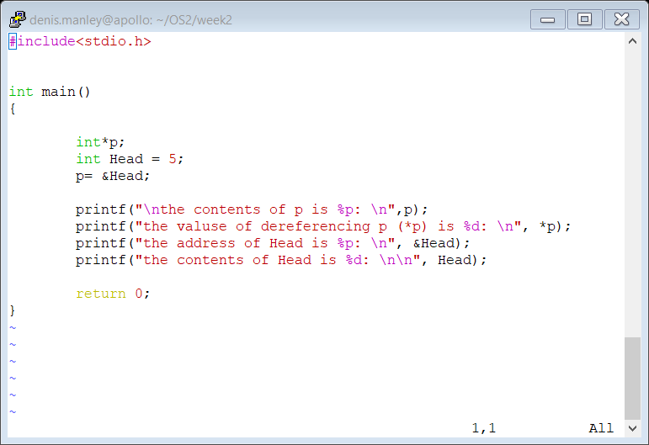
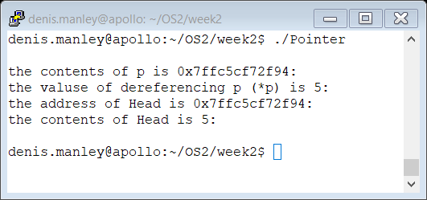
Code and output of Pointer.c

Slide 4
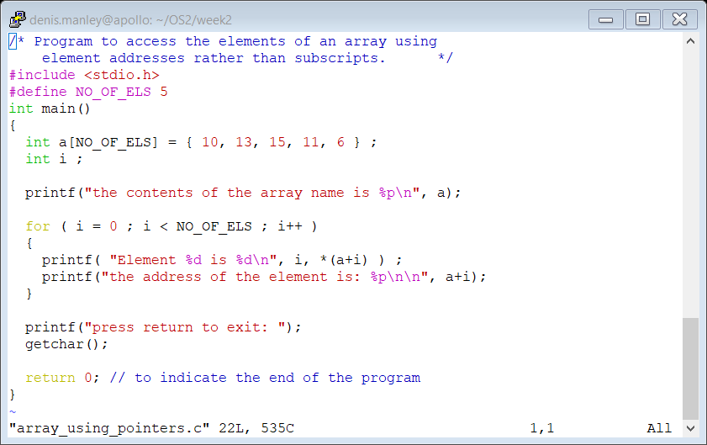
Pointer arithmetic
An array can be transverse using subscripts but can also transverse it using (variable) pointer notation. // example from C programming by Paul Kelly
What is stored in a
Can the value stored in a be modified.
Change a to a character and then a float array. What is the difference?

Slide 5
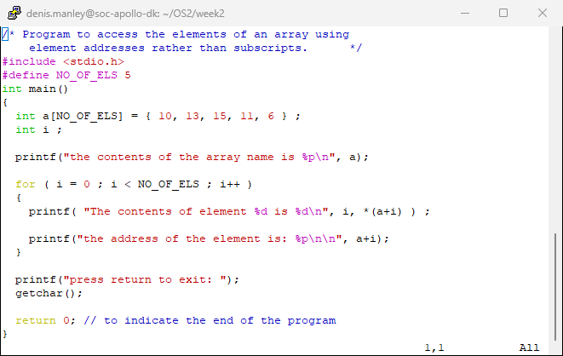
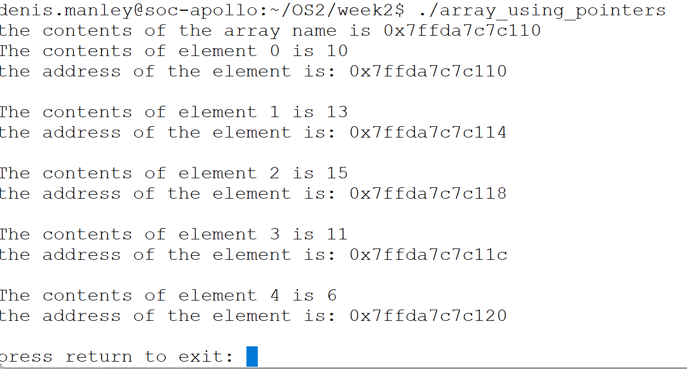
Explain “Output” of following code
the above is a integer

Slide 6
Pointer arithmetic
Using ++/--…. (See Char_pointer_arithmetic.c)
You can not increment an array name as it is a constant pointer (a++ is invalid)
However by assigning a standard pointer to an array you can increment using “pointer arithmetic”…
int *ptr;
int Numbers[25] = {1,2,3,4,5,6};
prt = Numbers; //assign the array pointer to the pointer variable;
Now can use p++ to increment elements… but ensure it remains within the “bounds of the array”.

Slide 7
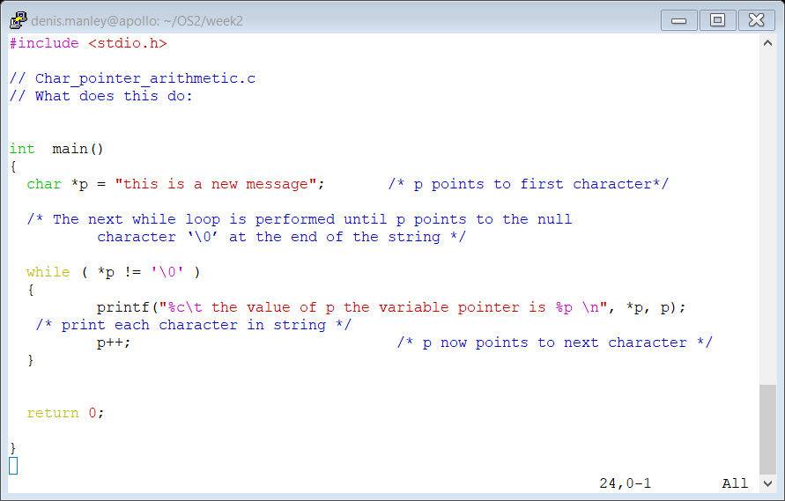
Char_pointer_arithmetic.c

Slide 8
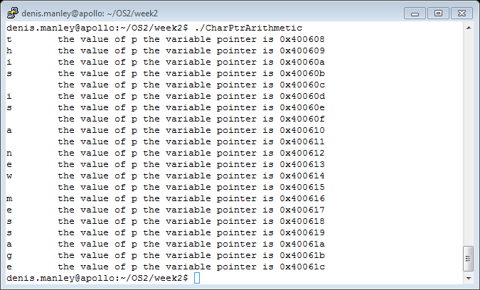
Explain Sample output

Slide 9
Functions
A function is a way to allow the reuse of code
There is three steps:
Declare prototype (tells compiler value returned, number of parameters, parameter type…)
Call a function: This is where program execution is directed to the function (most calls are in the main function but can be in any function: a function calls a function)
DataType FunctionName (parameter list)
Function definition
DataType FunctioName(parameter list including datatypes)
{
Function statements
Return value (if not void)
}

Slide 10
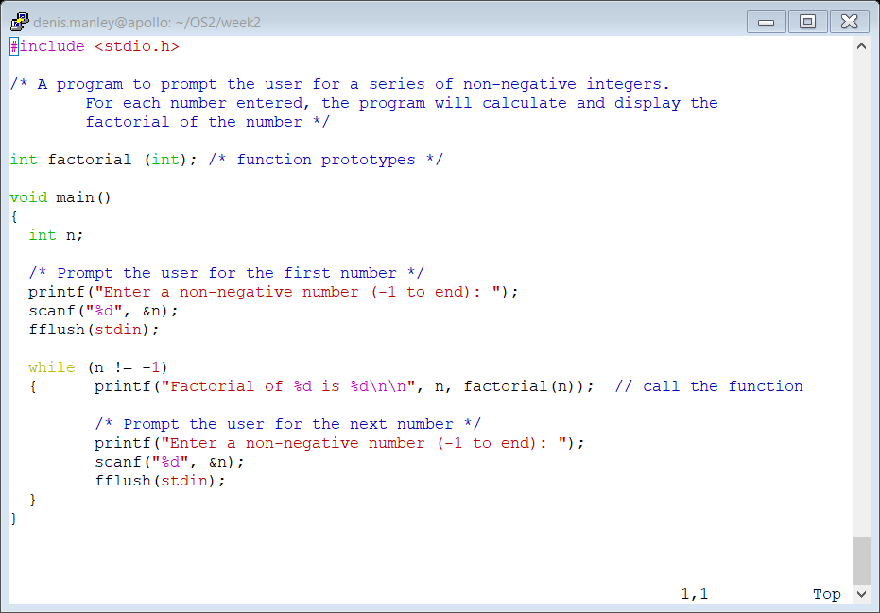
Calling the function

Slide 11
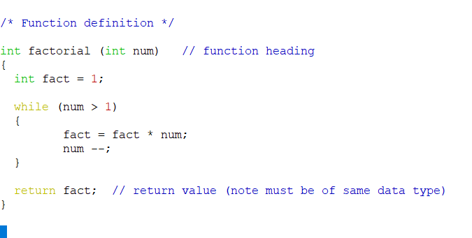
Function definition

Slide 12
Pass by Value/reference
By Value
Does not change the variable (actual) that is being passed to a function
Just pass an variable by using variable name…
The formal variable (in the function heading) is then a copy of the actual variable
By reference
When you want “to see if” the variable has been changed by the function
Must pass the address of the variable
Any changes are made by referencing the address passed to the function; the address of actual variable
By default an array is passed by reference. in order to prevent this use const in the array declaration

Slide 13
Swap example (by reference)
// reference Paul Kelly chapter 11
/* Program to demonstrate passing two arguments by reference. */
#include <stdio.h>
main()
{
void swap( float *ptr1, float *ptr2 ) ;
float num1, num2 ;
printf( "Please enter two numbers: " ) ;
scanf( "%f", &num1 ) ;
scanf( "%f", &num2 ) ; // step 1
/* Swap values around so that the smallest is in num1. */
if ( num1 > num2 )
swap( &num1, &num2 ) ;
printf( "The numbers in order are %.1f %.1f\n", num1, num2 );
}

Slide 14
Swap function
/* Function : swap
Purpose : This function swaps two floating-point values.
Arguments : pointers to the variables to be swapped. */
void swap( float *ptr1, float *ptr2 ) //step 2
{
float temp ;
temp = *ptr1 ; //step 3
*ptr1 = *ptr2 ; //step 4
*ptr2 = temp ; // step 5
}

Slide 15
Strings
A string is very similar to a character array:
What is the difference between them? Hint : ‘/0’
Declaration of a string
Use char name[SIZE];
Input values to a string using scanf (“%s”, …) or fgets(name, SIZE, stdin).
Output results with printf(“%s”, name) or puts (name)

Slide 16
Common String Functions
#include<string.h>
Strlen: determines number of characters (not including the ‘\0’;
len = strlen(string);
strcpy (destination , source); copies contents of source to destination
Destination and source are strings
{ensure destination is big enough to take source}.

Slide 17
Common String Functions
Strcmp(str1, str2)
Compares two null terminated string and returns
Zero if str1 == str2
Returns A negative value if str1 < str2
Returns A positive value if str1 > str2
if (strcmp(password, user) == 0)
printf(“Password correct. Welcome to the system”);
else
printf(“Invalid password”);

Slide 18
Write the strlen using char pointers
Modify the char pointer arithmetic code to calculate strlen function.

Slide 19
Pointers to pointers
A pointer can also pointer to another pointer which in turn pointers to a “standard” variable:
int i=3; // an integer variable int *j; // a pointer int **k; // a pointer to a pointer (double pointer)
j=&i; //line 1 (assigned address of an integer)
k=&j; //line 2 (assigned the address of a pointer)

Slide 20
Examples
What is output of the following statements
printf(“%d”, **k);
printf(“%p”, *k); printf(“%d”,*j); printf(“%d”,i);
Assume the following: i = 3, j = &I; k = &j

Slide 21
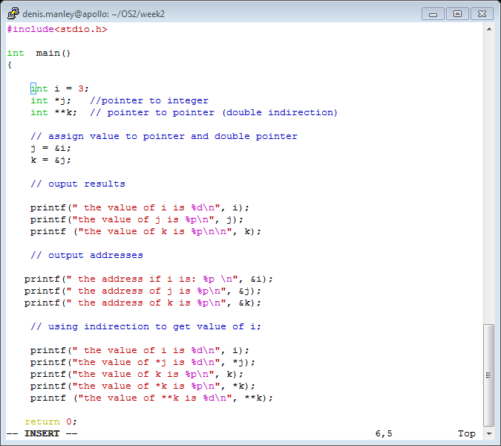
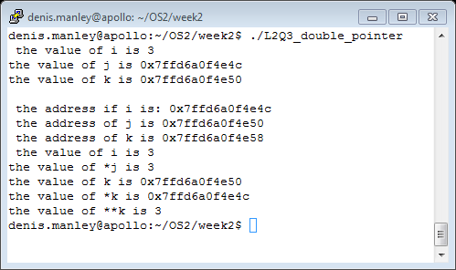
Double_pointer code and output

